Slide 1
Football Leagues Analysis

Slide 2
Introduction:
This analysis is made in order to find useful insights into football’s top leagues in the world.
The data includes all the matches of the most competitive 6 Leagues in Europe from 2000 to 2021.

Slide 3
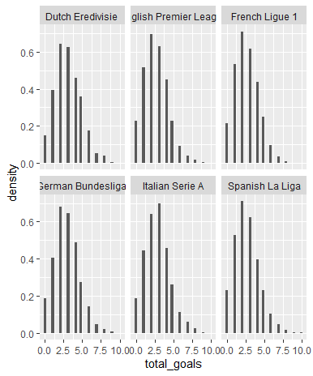
Total goals in different leagues:

Slide 4
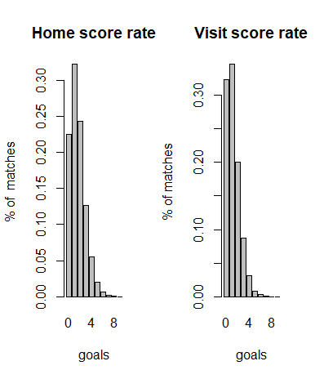
Home vs Visit Goal Rate:

Slide 5
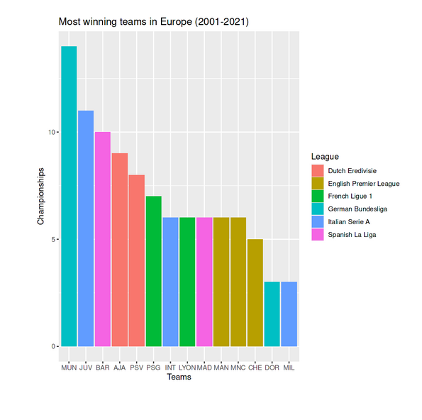
Most Winning teams:
We can see that Bayern Munich is the most winning team in Europe from 2000 to 2021.

Slide 6
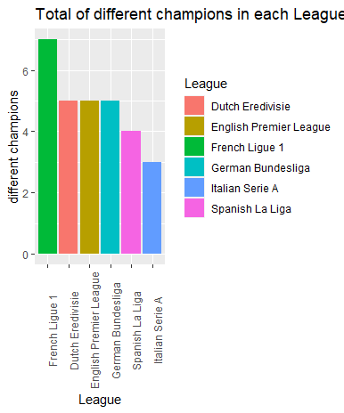
Number of different champions:
We can see that Italian Serie A is the most-dominated League, having only three different champions in more than 20 years.

Slide 7
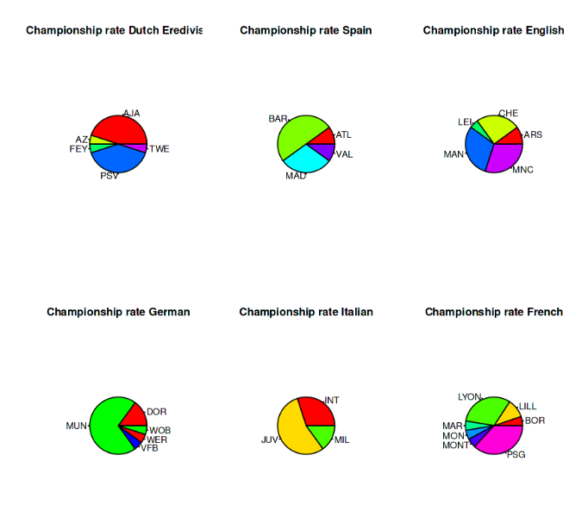
(contd)Pie Chart:

Slide 8
Conclusion:
We can see a lot of differences between the total of goals and championships distribution within Leagues. For example, Italian Serie A is the League with fewer different champions having only 3, but the most dominated League is the German Bundesliga, being highly dominated by Bayern Munich.

